Slide 1
Application Replatforming
Leveraging your Platform Investments

Slide 2
Help me maximize my return from my new cloud platforms.

Slide 3
Cloud Native: The Application Journey
Runs on Legacy IT
Re-platforming (minimal changes)
Runs OK on a cloud platform
Rewriting (12-factor principles)
Runs well on a cloud platform
DevOps Transformation (CI/CD)
Runs great on a cloud platform
Greenfield (microservices)
Cloud-native
Notes:
The following slides will describe the steps in this “journey”

Slide 4

Modernization Approaches for Existing Portfolio
Replatforming
Rewrite
Operations Focus
Application Focus
Migrate application to cloud platform
Minor changes to “make it work”
Enable test-driven development (TDD)
Operationalize platform for support
Adhere to 12-factor principles
Employ micro-service architecture
Find, test, refactor around “seams”
Continuous delivery; rapid prototyping
4 of 27

Slide 5



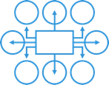
Application Replatforming
Primary mission is to enable the rapid and successful migration of existing applications to any cloud platform (multi-cloud)
Lower the operations cost via automation
Accelerate return on investment of cloud platform
Resiliency through auto scale
Support for blue/green deployment
Governance via self-serviced tools/frameworks and automated testing
Centralized configuration management
5 of 27

Slide 6
CLOUD NATIVE METHODOLOGY
LAUNCH
SCALE
TRANSFORM
Tactical win demonstrating value and showcasing what is possible.
Develop and hone process, practices, and toolkits for repeatable success.
Modernized operating pattern, platform, and process for sustainable change.

Slide 7

Tactical Win
Capture “Low Hanging Fruit” with Replatforming
WHAT TO MOVE
HOW TO MOVE
Identify “cloud ready” application compatible with PCF
Prioritize workloads and applications
Refactor common code and configuration issues
Verify & validate functional and non-functional capabilities

Slide 8
Key Project Components
Quickly demonstrate value (aka. Apps running in PROD)
BACKLOGS
TARGET PLATFORM
Business Units
Replatform
Replatform App
Business Units
Cloud Native Assessment
Business Units
APPS
READY
Modernize
Native Hybrid Cloud w/PCF
NOT READY
Other

Slide 9
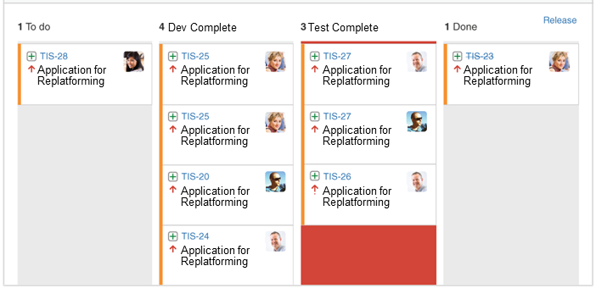
Agile Management Methodology
Migrate Incrementally
Scrumban Methodology
Projects start with a set of pre-kickoff and preparation activities
Backlog templates are modified to fit project context
Scope is shaped and prioritized daily with the team
Work-in-progress limits set; focus on PROD
Weekly reviews of completed work, blockers, etc.
Engagement Toolkit
Jira for project management and reporting
GitHub for code management and collaboration
Application/Component/Workload

Slide 10
Classify Application
MOST
Cloud Native
Cloud-first design pattern using micro-service architecture and principles; API first design
Cloud Resilient
Designed for and proactively testing for failure; Apps are unaffected by dependent service failures; Cloud agnostic runtime implementation
Cloud Friendly
Early adoption of 12-Factor App tenants; leverages platform for HA and scalability
Cloud Ready
Typically self contained application with no file system requirements; supports async and stateless transactions
MATURITY

Slide 11

Replatforming Evaluation Checklist:
Application characteristics to avoid
In-bound connections for non-http protocol
Use of container-hosted clustering
Stateful processes
Use of distributed transactions of any kind
Use of file system
Use of hard-coded configuration
Non-standard security

Slide 12

Seed DevOps Practices
Collaborative Teams
Test-driven Development
Continuous Integration
Platform integrated with Pipelines

Slide 13
Help me scale early wins and create new operating patterns that support my new cloud platforms.

Slide 14
Enterprise Success Pattern
Performance Metrics
Reporting
Non-compliant Pathway Design
Process Optimization
PROGRAM PLANNING AND MEASURES
WHAT TO MOVE
HOW TO MOVE
REPEATABLE
Identify “cloud ready” application compatible with PCF
Prioritize workloads and applications
Refactor common code and configuration issues
Verify & validate functional and non-functional capabilities
Develop migration frameworks and analysis tools
Introduce continuous integration/ deployment capabilities
PLATFORM EXTENSION & ENABLEMENT
PCF Operations
Resiliency
Continuous Delivery
Scaling & Availability

Slide 15
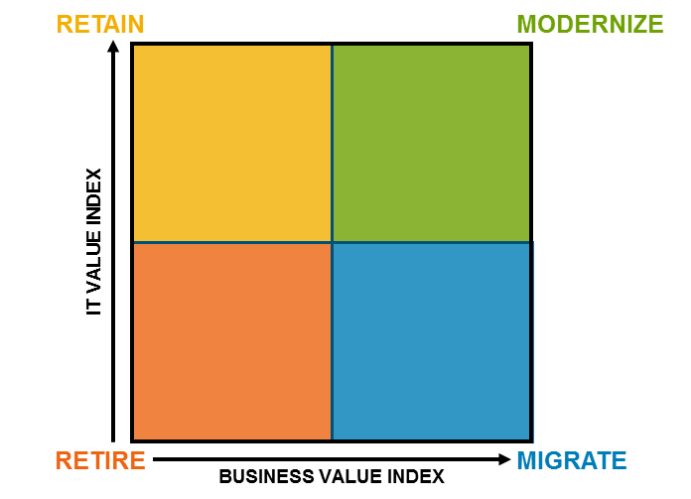
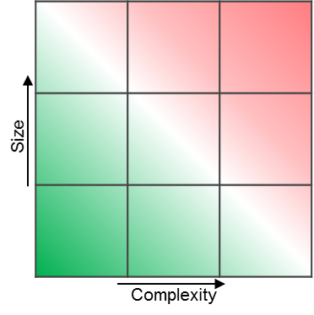
Assess & Target Non-Cloud Ready Applications
Data-driven decisioning for categorizing and prioritizing work
PCF or Service
Fabric
Business:
Business criticality
Impact of system failure
User demographics
Regulatory/legal risk
CapEx/OpEx
Jurisdictional concerns
Confidentiality
Azure Stack
Public Cloud Azure
Not Recommended
Technical:
Hardware, software, OS, Database
Latency
Availability
Scalability
I/O
Interfaces
Cost
Pre-Qualified
Applications
Financial:
Hardware
Software
People/Labor
Facilities/Accommodation
External
Network
Overhead

Slide 16

Continuous Delivery w/PCF
Accelerate Change via Automated & Orchestrated Pipelines
get dependencies
Artifact Repo
build
Build
Source Code
Test Framework
release candidate build
known good artifacts & build packs
code
commit
Base Deploy Pipeline (Concourse)
cf push
cf push
cf push
cf push
Pivotal CF
Pivotal CF
Pivotal CF
Pivotal CF
DEV
TEST
STAGE
PROD
Application
3rd Party Testing, Verification, and Validation Tooling

Slide 17

Emerging Standards, Frameworks, Tooling
Application-centric governance models
ENTERPRISE
PORTFOLIO (L.O.B.)
ARCHETYPE
APPLICATION
APP 1
APP 2
APP 3
APP 4
Notes:
Think in layers
Enterprise = thin layer >> common lang and lifecycle stages
Bottom = thick >> own by product team, specific to application
BUILD iteratively, as new apps added, refactor model
It is our recommendation to the Bank to think in layers when modernizing the governance model. The model needs to reflect the community, applications, and workloads that it supports. At the enterprise levels, a lightweight set of standards, policies, and workflows are defined. These standards, policies, and workflows incorporate global expectations regarding design, quality, architecture, lifecycle, etc. that are applicable to ALL applications and products in the portfolio regardless of the business unit, type, and feature set. At this level, it is about setting up guardrails, not dictating tools, frameworks, and processes. By setting this thin layer at the Enterprise level, disparate business units and product teams can effectively communicate and share progress vertically or horizontally across the enterprise using the same language and lifecycle stages.
At the bottom of the stack are specific application and team standards, policies, and workflows. These are defined and maintained by the product teams in the context of the upper layers. These lower layers allow for different business units and application types to follow different workflows, use different tools, and comply with different standards. For example, a customer-facing, mobile banking application will have different security, compliance, and branding standards than an internal IT service for provisioning development labs.
What is important to remember is that the governance model is built iteratively. As new applications and product teams are on-boarded, the standards, policy, and workflow need to adapt. It is not uncommon to see once enterprise standards move down to the portfolio or archetype layers as new business units and products get added to the supported portfolio. We strongly urge against the traditional approach of getting a lot of smart people together and trying to define all these layers up front. It is rarely effective and often leads to nothing but shelf-ware. This is typically where SMEs attempt to overfit the past onto the future. Be cautious of this tendancy. Just because you are doing it today doesn’t mean you should continue to do it moving forward. Be critical and be creative.

Slide 18
Cloud Native Platform Design Pattern
X-as-a-Service
Portals/ Dashboards
Continuous Integration
Configuration -as-Code
Test -as-Code
Compliance -as-Code
Database -as-Code
Security -as-Code
Standards -as-Code
Performance -as-Code
Data Srvs
Framework Srvs
Messaging Srvs
Logging Srvs
Etc.
Self-Service
Info Radiators
Work Hubs
Application Continuous Delivery Pipeline
Common Continuous Delivery Pipeline (Orchestrator of Orchestrators)
Cloud Platform Continuous Delivery Pipelines
Server-as-Code
Container -as-Code
Storage -as-Code
Network -as-Code
Backup -as-Code
Performance -as-Code
Security -as-Code
IaaS/PaaS Controllers/Management Layer
Hypervisor
Public Cloud Provider
Infrastructure Pipelines
Compute/Network/Storage

Slide 19
Key Take-aways
Start small, prove, then radiate success
Limit work-in-progress, more important to get to production
Learn from successes and define standards, frameworks, policies from success
Don’t get stuck

